Slide 1
Your website?
It's not FOR you.
Notes:
My name is Valerie Adler, and I own The Right Website, a WordPress business that offers websites, hosting and SEO to to small and medium-size enterprises.
I used to work in the public sector in a Business Improvement role, and as a project manager for large IT implementations. My expertise was not technical – I don’t have an IT background, but I love IT - but rather on interpreting the requirements of the business, defining a solution from a business perspective and communicating that to the IT folks in order to maximize business benefit when that solution was delivered. When I decided to find a freelance business that met my nomadic lifestyle ambitions, I had the thought that I would become a small business consultant who could also deliver websites; I liked the idea of keeping some techy component to what I did.
That’s not how it worked out. Instead, I settled on WordPress and became totally absorbed by its accessibility, and its possibilities. I zoomed in on doing the techy bits, because I could learn and DO so much so quickly, so now it turns out that I deliver websites, wrapped in business consultancy. That inevitably includes a lot of discussion about SEO.
With practically the entire world online, it’s easy to see that any customer you might ever hope to have is out there in that noisy space that is the internet. In order to FIND your customers in that noisy space, you have to be hitting the right notes in order for them to hear you. A big part of what I do with my clients is to help them understand who it is they’re trying to reach with their websites, and with their businesses.
Honestly?
I'm not an expert on SEO. I would not position myself that way, and I regard many of the people who do with a high degree of suspicion. SEO, as an industry, is clogged with cheats and charlatans who gain traction because it is a genuinely worrying subject, and it’s very easy to take advantage of people when the feel that they’re out of their depth.

Slide 2
"No one can guarantee
a #1 ranking on Google.”
support.google.com
Notes:
Who in this audience hasn't had the emails promising page 1 ranking on google, from people who don't provide so much as a company name or a phone number...? Hands up? I thought as much. If you’re bloggers and you’re not using being careful, you may also get those offers in the comments on your blog, too.
GOOGLE, ON THE OTHER HAND, SAYS NO ONE CAN GUARANTEE A #1 PAGE RANKING. So that’s the bad news.
But there is good news!
You don't need to be an "expert" on SEO to know quite a lot about some of it. While the algorithms that Google use are changing all the time and are kept secret anyway, we CAN recognise what Google is trying to deliver as a search engine.
At the simplest level, Google is trying to deliver an appropriate response to the question being posed by the person who is using Google to find something. That’s pretty simple, right?
MY objective for today is also pretty simple: To convince you that SEO is not really a dark art and that – so long as you have a clear vision of what you do, and a clear understanding of the people in your target audience – you will be able to satisfy Google’s most important requirements for getting a good page ranking for your site.
A proviso here is that there are several significant SEO activities to put on your to-do list, of which many are technical, but today I’ll be talking almost solely at content.
SO, BACK TO MY POINT OF DEPARTURE :

Slide 3
Your website?
It’s for your audience.
Notes:
…YOUR WEBSITE ISN’T FOR YOU.
Your website is for the people with whom you want to engage…ideally it’s there to establish you as trustworthy, credible, and the MOST desireable source of the goods and services you sell. You need to build your content to encourage the right people to come to you.
Your starting point HAS TO BE that you have a crystal clear MISSION. You need to be clear about your product, your service, or - if you’re a blogger – why you do that. You may have heard the expression elevator pitch...it means what you would say if you were riding a lift with a prospective customer and had just half a minute to say – and to sell – what you do.
YOU’D BETTER KNOW WHO YOUR AUDIENCE IS. If you’re crystal clear about THAT, you can aim that pitch. But, of course, you’re not in the elevator yet. SEO is like trying to get your prospect into the elevator in the first place.
Doing your SEO well relies on your understanding WHO you target audience is and, critically, HOW they look for you.
It’s important to narrow your sites and set them precisely on your target audience. You have to visualise your clients. It may be counter-intuitive, but I would argue that the more you find a niche, the more successful you will be.
I’m also going to talk about how Google looks at your site, and quote Google’s recommendations for improving your chances of getting good page rankings.
More good news: These two things are entirely compatible.

Slide 4
Google says...
Notes:
I often hear myself saying to my clients, “Google says”…or “Google doesn’t like that...”
So, when you see quotes here, I want you to know that this is right from the horse’s mouth: these are ACTUAL QUOTES from Google’s pages for Webmasters, Developers…and Google’s own blog on Searching.
Let’s start with what Google says about ITS mission.

Slide 5
"Our primary goal is to serve users with high-quality, relevant information."
Notes:
"Our primary goal is to serve users with high-quality, relevant information.“ Like I said, it’s pretty simple.
The key words here (not the keywords!) are HIGH QUALITY and RELEVANT. And Google’s reputation stands or falls on its ability to do a good job in this.
So, high quality means interesting, original, useful, well written…there are plenty of adjectives to elaborate on what we mean by high quality. What we DON’T mean, is scraped, plagiarized, duplicated content, blocks of content that are copied from elsewhere without any value being added by you. We’ll assume you know what you’re doing, and that people are ready to respect you for how well you do it.
Really, RELEVANT is the key to this statement. Relevant means several things, relevant to the search terms being used, relevant to what you actually do, and relevant to the person who is using the search terms.

Slide 6
RELEVANT TO WHOM?
Notes:
So, be very clear about your Mission. What have you set out to do, and for whom are you doing it?
If you can really picture your target audience, and write your content for that audience, relevance will surely follow. If you’re genuine about what you’re offering, and you can explain it with your target audience in your mind’s eye, you’ll find it much easier to engender confidence in the conversation you’re having with the people in that space.
Is your target a university educated mum who is looking for some advice on infant nutrition? A young professional, looking for tips on real estate? Young newlyweds, looking for investment advice? A pensioner looking for a way to care for his wife with Alzheimer’s? What do these people look like, and how do they look for the things they need?
Maybe your target is a business, one that is big enough to have a few employees, but not big enough to have an in-house Human Resources team. Maybe this company is struggling with a long-term sickness issue and doesn’t know how to manage it. I have a client who is an HR specialist, and small companies with issues like that are HER target.
Maybe your target is someone looking for WordPress training. That’s a service I offer. What does that person look like? Who is she? What does he know about WordPress already? How far are they down the track of identifying their business goals?
Here’s one thing we all have in common, though: we’re looking for the customers WE want, whatever they look like. They’re the ones who can afford what we do, those people we have a high chance of satisfying (because happy customers bring more business), and they’re the ones who want to work with us. No matter what you deliver, the relationship is going to be of prime importance. Ideally, we all want to work with people we like, and the ones who want to work with us.
If we can really hold up a picture of that person, or those people, we can start a dialogue..an honest conversation that will bring us the business we’re looking for.
Google’s breathtakingly complicated algorithms are designed to match your ideal client with your ideal client’s ideal supplier. Which we hope, is you.

Slide 7
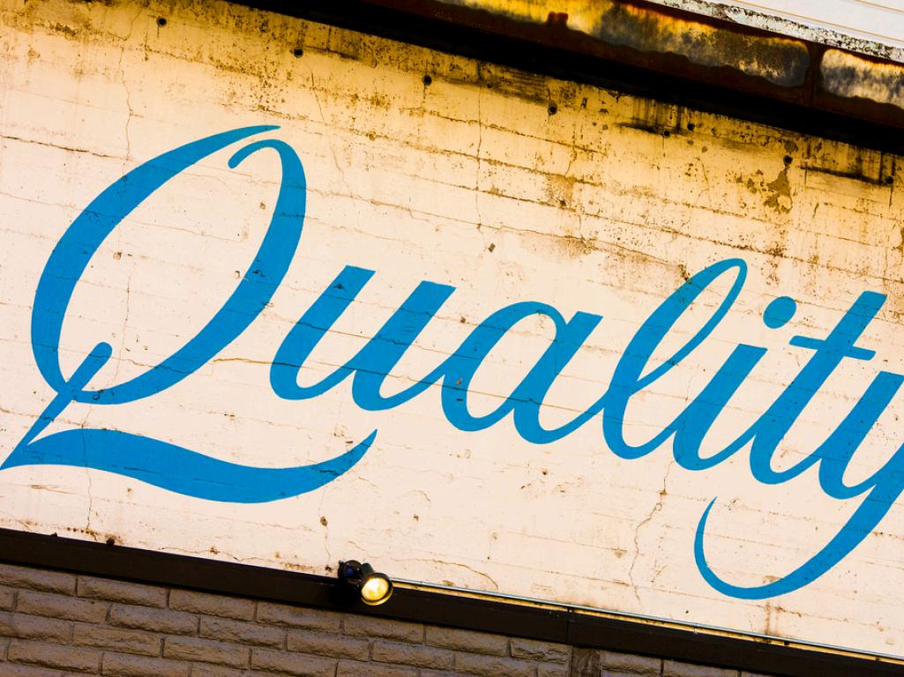
"Write good-quality,
relevant content."
Notes:
Now THIS is Google’s number one SEO recommendation. You can’t skip this one.

Slide 8
"Give visitors the information they're
looking for."
Notes:
Also, straight from Google: GIVE YOU VISITORS WHAT THEY’RE LOOKING FOR!!
Well, you’d think that was pretty obvious, really. That’s not just about the website, that’s about having a business that has a hope in hell of succeeding.
But, let’s say they’re looking for WordPress training. As I said, that’s a service I offer. When I googled “WordPress Training” yesterday, I got over 92 MILLION hits. I wasn’t on page one, or page two, or three…and I stopped looking there because, in effect, I was nowhere.
So, a person might be looking for WordPress training, but they’re not going to find me. Hmmm…maybe those visitors – you know, those visitors I’m not going to get – aren’t the ones I want anyway.

Slide 9
"Think about the words users would type
to find your pages."
Notes:
So, this piece of advice from Google is really useful to me. This is actually your second most important job, right after being able to articulate what you do: it’s visualising your customers and figuring out what words they will use.
Let’s be honest. When we search for something, what’s the most likely thing to happen when we don’t see what we want on page 1?
Do we look at page 2, or maybe even page 3? Or do we change our search term immediately?
How many of you look on the next page or pages? How many change your search term? I do the latter, and I’ll bet that’s what most people do.
The trick is to narrow it down.

Slide 10
Know how to string those words together
Notes:
When we talk about keywords, what we mean by that is really phrases, small groups of words, generally in natural language. When we string more words together than just two or three, we call that a long tail keyword.
If I can’t get the hit on WordPress Training, maybe I need to be more precise. Maybe I need someone who wants “WordPress training in Chichester”, or in Worthing. When I include those more specific phrases, voila! I do actually make page 1 for those search terms.
But, when you start to get really specific, you start to feel a little trapped…because now you’re speaking to a small group, and this may not represent all of the customers you’re trying to reach.

Slide 11
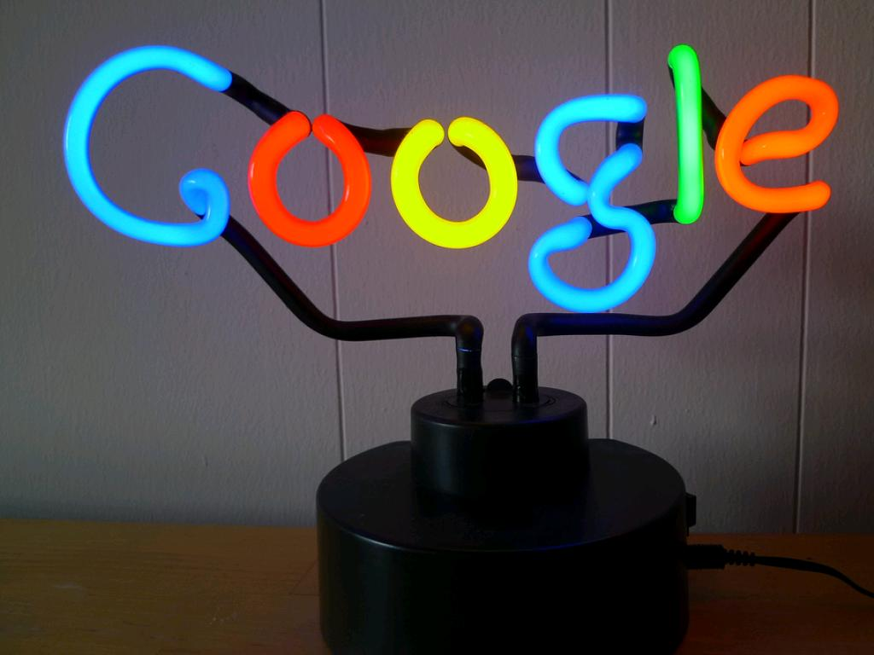
Sites don't rank. Pages rank.
Notes:
What if you have a very diverse audience, or more than one audience? Or what if what you do is really technical, but your audience won’t know your jargon? You want to demonstrate your expertise to a range of people, and that might seem like a dilemma.
It’s a relief, then, isn’t it, to realise that you have the chance to hit a wide range of search terms without cramming them all together on one page – or on every page. That wouldn’t be natural, and neither your reader, nor Google, would think much of THAT.
But, websites don’t rank… pages do. Which means you can write blogposts or static pages that speak to a range of subjects, thinking carefully at the start of the purpose of that post or page, who it’s for, what it’s designed to do. Pick your keywords, or better yet, your long-tail keywords, and write to them.
The great benefit to using long-tail keywords is that, although these keywords may be used less often that the more generic terms, the visitor who uses them to find your site will be most likely to stick around when he finds it, because it’s genuinely what he was looking for. Provided the content around that search term is truly relevant to it, that’s a good hit.
If it isn’t, and he bounces straight back out, that’s a bad hit. So remember this: relevant equals honest.
Now, if you DON’T think about your SEO at the beginning, you might do what my HR client did with one of her first ever blogposts. We’d just put together her site aimed at small businesses, playing the “isn’t HR a nightmare” card. She then set about blogging to do all the things we know that blogging is great for: establishing credibility and trust, really, for priming the pump so that people who don’t need you now will think of you later, when they do.
Her first post was all about changing legislation which affected businesses with more than 25,000 employees. She brought this to me so we could SEO it for her target audience.
I asked, um…don’t you think that companies with more than 25,000 employees can probably afford some pretty hefty in-house Human Resources resource? And, don’t you think it might frighten away the small businesses you’re targeting if they think you’re working for such large organisations.
But I said, hey, it’s not all for nothing. It shows you have knowledge. You can do this from time to time, but now we have to think about writing for your actual audience! The hardest thing we had to work through was getting her to dispense with a lot of employment jargon, the abbreviations, acronyms and industry specific phrases that often come with the territory when you’re a specialist.
I did another website for an Optometrist. She’s written a lot of highly technical articles on malformations of the eye. These establish her pedigree, but offer no direct SEO value because virtually no one with eye troubles will ever use any of the words she using in those articles. But, she’s writing other stuff now, too, with long-tail keywords describing frustration with dry eyes or uncomfortable contact lenses.
You don’t have to optimise every page – but you have to think about your audience before you write your content. End of story.

Slide 12
Knowledge Graph:
“we’re growing up…”
~ 16 Nov 2015
Notes:
The great thing about Google’s ever-improving algorithms is that the better they get, the less the cheaters and charlatans will crowd the space you’re trying to occupy, and the more you’ll be free to devote yourself to writing high-quality, relevant content. You’ll be able to speak more naturally about what you do and worry less about hitting specific focus keywords.
Google’s Search blog, from just days ago, talks about how they’re getting to grips with complicated ideas. This example shows how sophisticated they’re getting.

Slide 13
Remember:
It’s for your audience.
Notes:
Before I finish…
There are a couple of other things I wanted to tell you:
Google likes mixed media…it crawls around and likes to see images, and video, for example, but remember that it can’t yet “see” images or video, so relies on alt tags for images. NEVER, EVER leave an alt tag blank – that’s a negative mark – and ALWAYS get your keywords in there. It’s the one place your don’t even have to use natural language.
As for videos, I’m sure you’ve noticed that often video have full transcripts beneath them. That’s to wring the SEO value out of both the FACT of video being there AND the words used in that video.
Google likes to see a clear structure. Funnel your information, starting with entry-level detail for the dipper, and let your site’s navigation carry divers further into the detail if they want it. Links are important, too. Try to link every page to at least one other…it’s not always that easy.
Here’s another REALLY important thing: be sure you make it easy for your visitors to do what you want them to do. Want newsletter sign-ups? Make sure the sign-up box is there at the end of your fascinating article so they can sign up for more. Want them to phone you? Say so. Want to sell them something? Write an enticing feature on one of your products and then link to that product in your shop.
Finally, use a good SEO tool. SEO by Yoast is terrific, but it only works as well as the challenge you set for yourself. Don’t pat yourself on the back too much if you get a green light for short, generic terms! Make it a hard-won green light, and then change the search term and see if you can get another for a similar term without unpicking too much of what you did for the first green light.
I mentioned earlier that my direction had changed, that I had intended to be a business consultant who delivered websites, but turned out to be a web “developer” who does a lot of hand-holding and business consultancy.
That change of direction is something I see a lot, as I work with a lot of small and/or new businesses, so the first site we build doesn’t always reflect what that business will ultimately become. My Human Resources client now realises that she wants to target some of those bigger clients (though not the ones with 25,000 employees.)
So, while I’m forever telling my clients that the best time to think about SEO is before you build your site, it’s truer to say that the best time to think about SEO is now, or it’s the next time you sit down and think about your website. It’s never going to be to late to make improvements…

Slide 14
Valerie Adler
The Right Website
www.rightwebsite.co.uk
Twitter: @rightwebsite
Tel: 01273 252373

